Slide 1
Centrifugation & Sedimentation
CHBE 446 Team #3
Allison Chung, Zachary Gaston, Jess Gorski, James Ko, Esther Tan

Slide 2
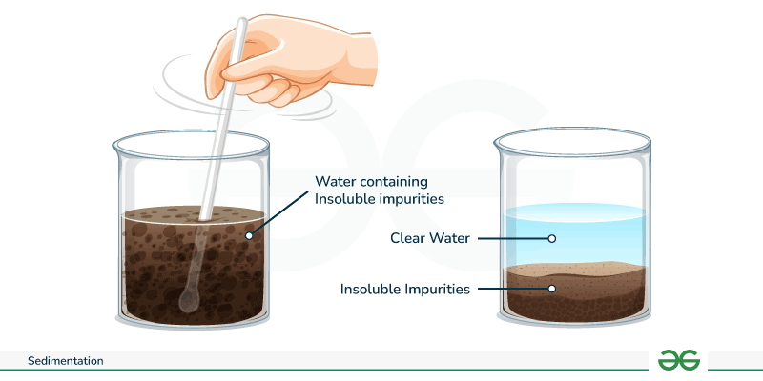
Sedimentation
Process of separating solid and liquid
Typically performed prior to filtration to isolate the larger compounds
Natural sedimentation due to gravity after a given period of time
[1]
Notes:
Jess
For a lot of separating processes, the duration of time needed for sedimentation is unfeasible.

Slide 3
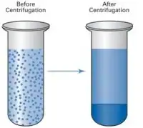
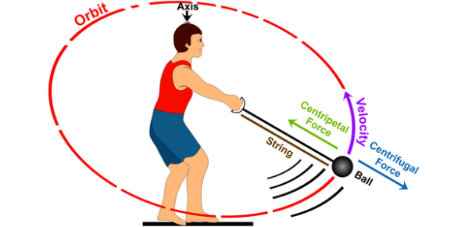
Centrifugation
Separate components of a mixture based on size and/or density
Application of centrifugal force
Separation can occur hundreds and thousands of of times faster than sedimentation
Factors that influence centrifugation:
  Density of both samples and solution
  Temperature/viscosity
  Distance of particles displacement
  Rotation speed
[2]
[3]
Notes:
Jess
Centrifugation is the similar to sedimentation except that there is the added component of a centrifugal force.
Various factors that influence the sedimentation rate of each particle

Slide 4
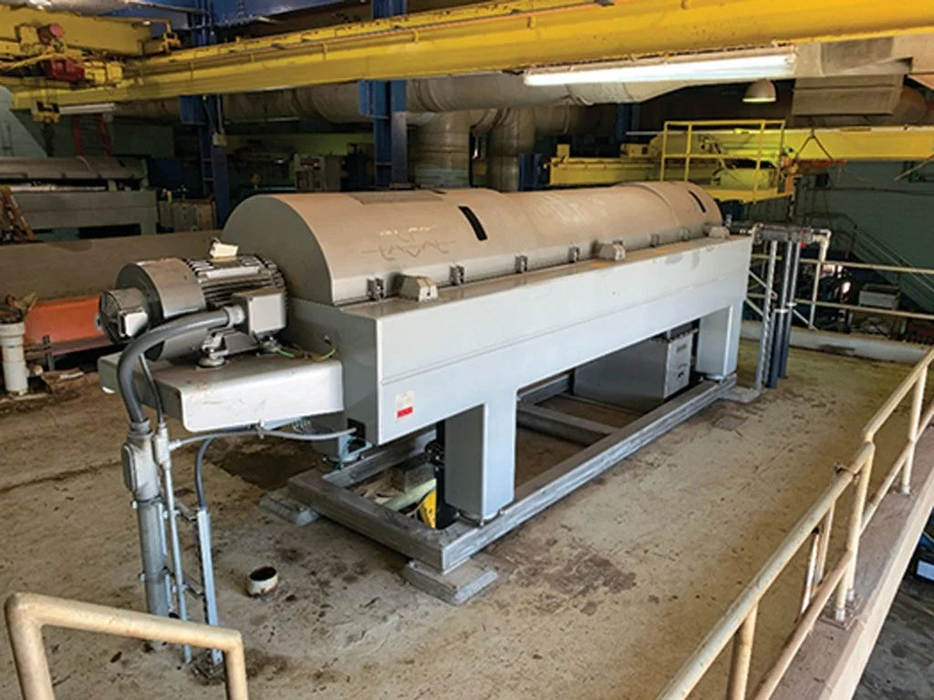
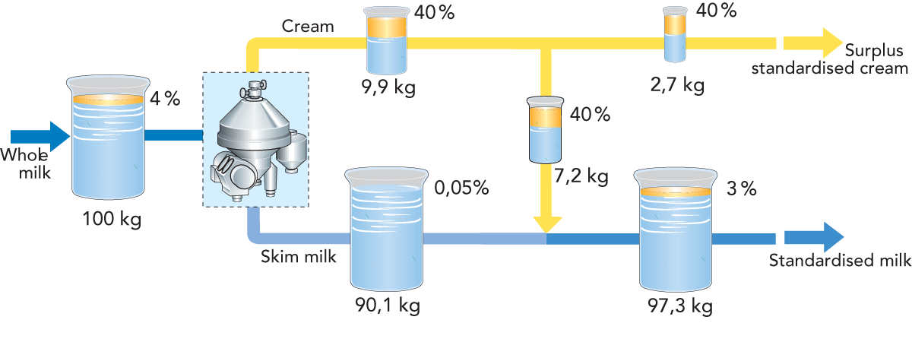
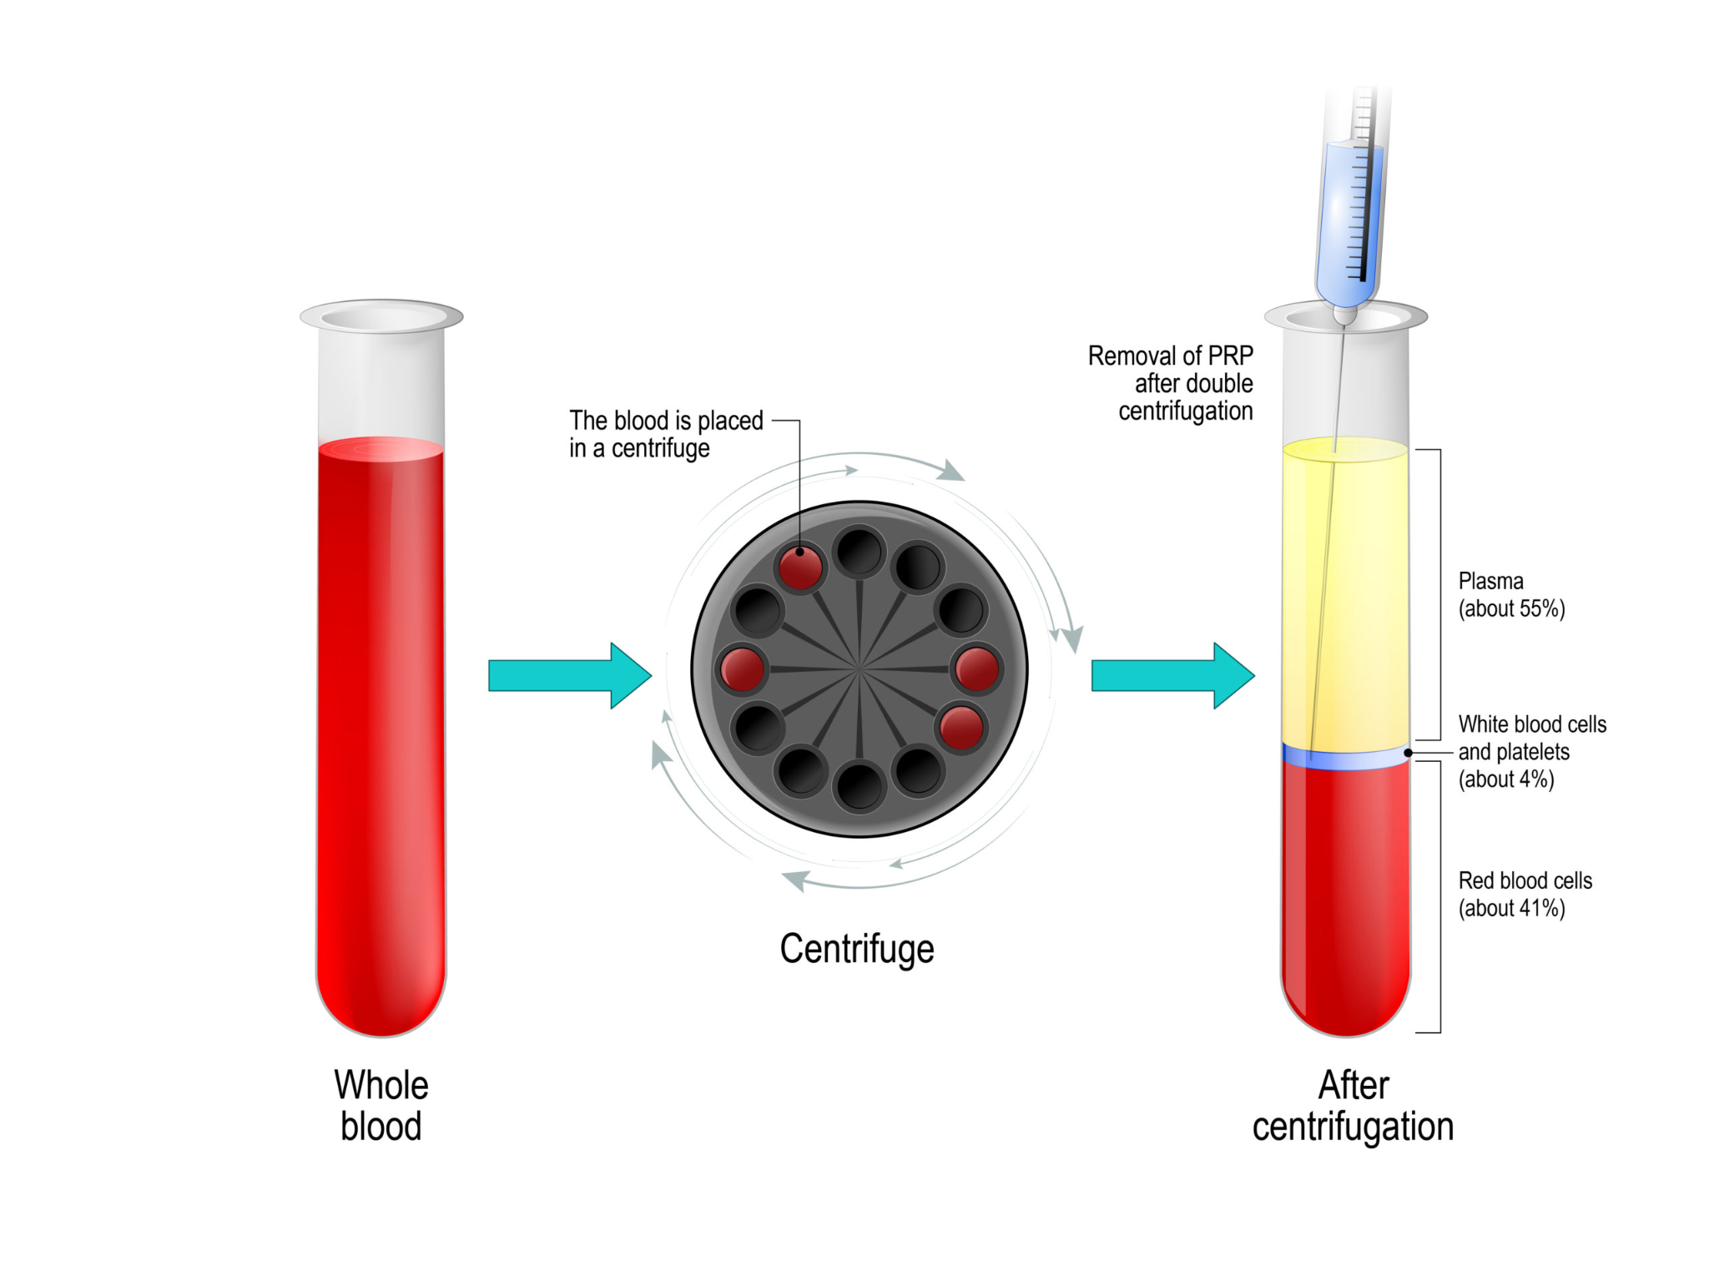
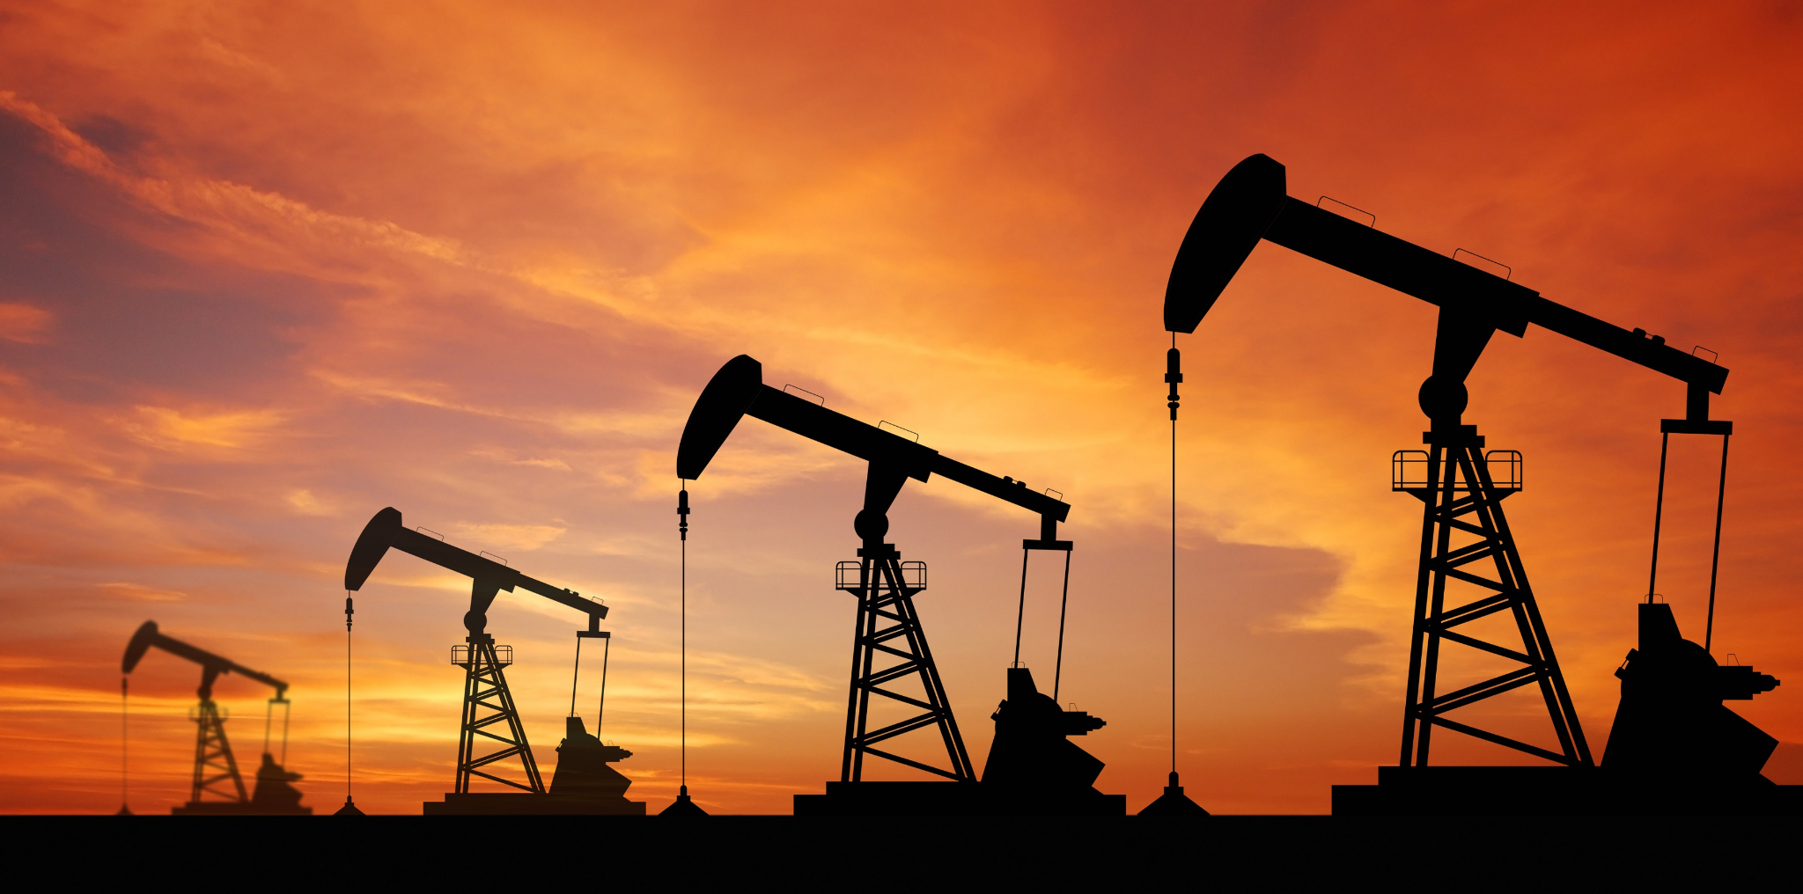
Applications
[4]
[5]
Food Processing
Wastewater Treatment
[7]
[6]
Biopharmaceuticals
Oil
Notes:
Centrifugation and Sedimentation are used in many applications.
One of the biggest ones is wastewater treatment. Centrifugation can be used to separate the solids from liquids and in turn, remove contaminants making the water suitable for discharge or reuse.
Centrifugation is also commonly used in food processing, biopharmaceuticals and processing oil.
Wastewater treatment:
Separating solids from liquids, removal of contaminants making the water suitable for discharge or reuse
Food Processing:
By using a centrifuge to separate fat from milk, you can remove the fat leaving skim milk behind
Oil

Slide 5
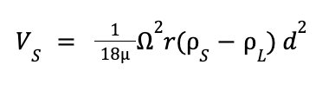
Stokes’ Law
The terminal (settling) velocity is determined by centrifugal gravity.
V_{S} = Settling velocity (m/s)
𝛍 = viscosity (kg/mᐧs)
Ω = angular speed of rotation (rev/min)
𝜌_{L}= density of solid (kg/m³)
𝜌_{S} = density of liquid (kg/m³)
d = particle diameter (m)
r = centrifuge radius of curvature (m)
Notes:
Esther
Focus on centrifugation
Centrifugation can be explained by Stokes Law
Settling velocity can be maximized with a high centrifugal speed, large particl size and large density difference between solids and liquids.

Slide 6
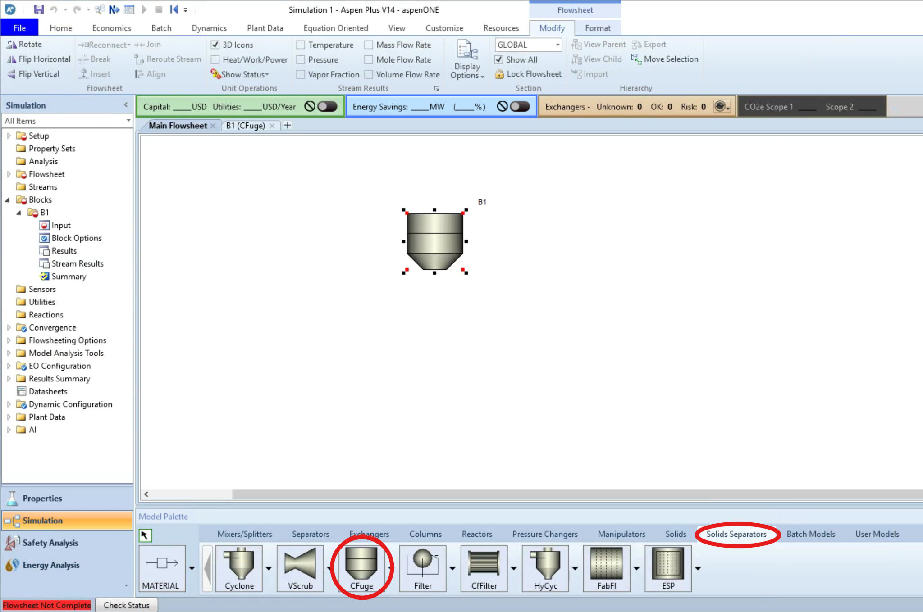
Centrifuge on Aspen
Notes:
Esther

Slide 7
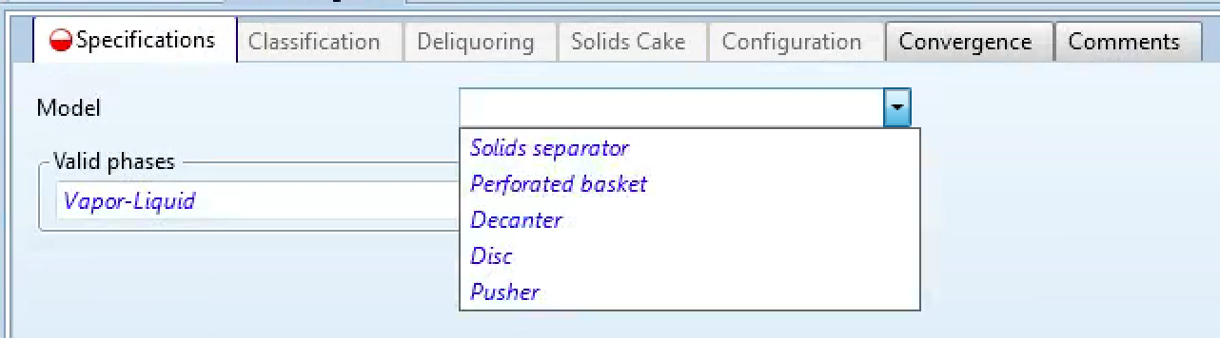
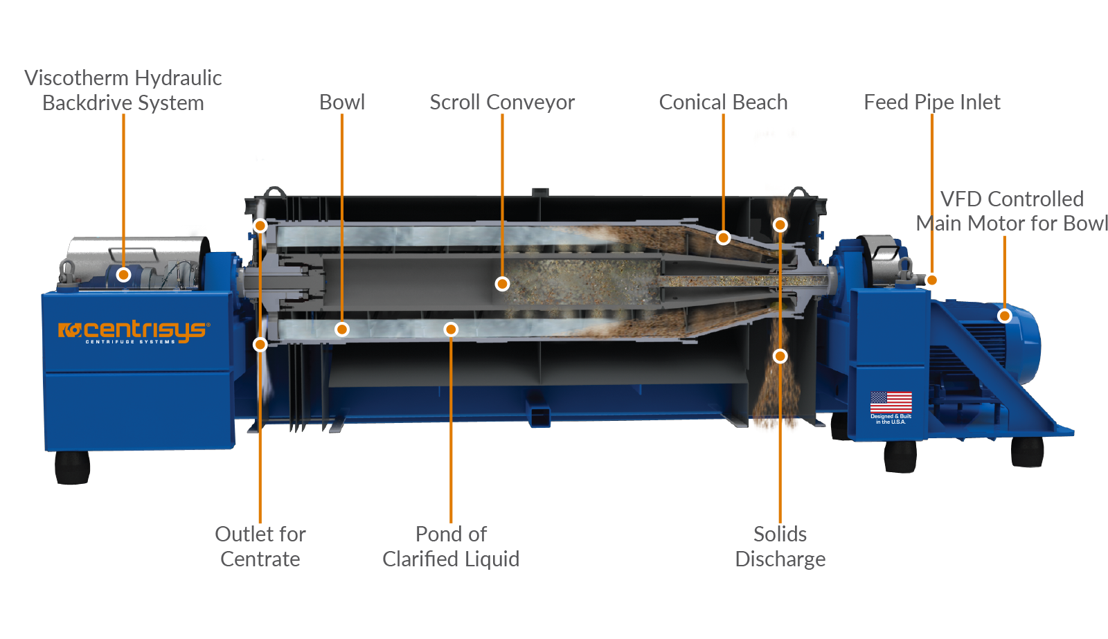
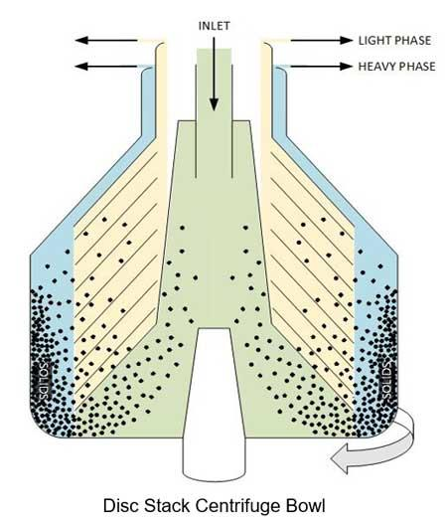
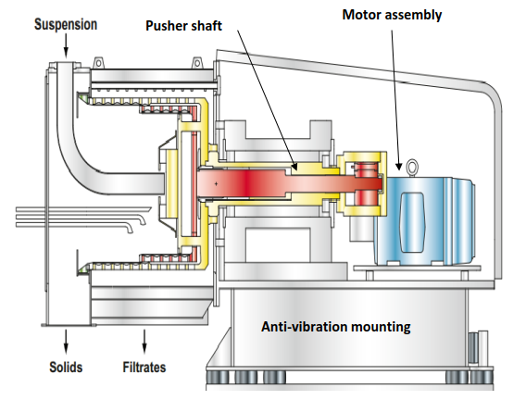
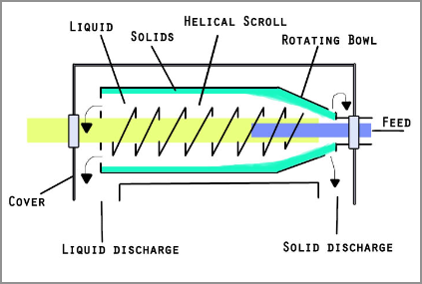
The Five Models for Centrifugation
The first step is to input the model the centrifuge will follow.
  Solids Separator
  Perforated Basket
  Decanter
  Disc
  Pusher
[8]
[9]
[10]
[11]
Notes:
Zach
Perforated basket (top right): https://www.wvodesigns.com/perforated-basket-centrifuge-50kg-724.html
Decanter(left): https://www.centrisys-cnp.com/blog/decanter-centrifuge-spare-rotating-assemblies-explained
Disc(right): https://www.machinerylubrication.com/Read/31902/disc-stack-centrifuge
Pusher (middle right): https://www.sultrade.cz/en/pusher-centrifuges-continuous-centrifuge/
Solids Seperator(middle left): https://en.wikipedia.org/wiki/Solid_bowl_centrifuge

Slide 8
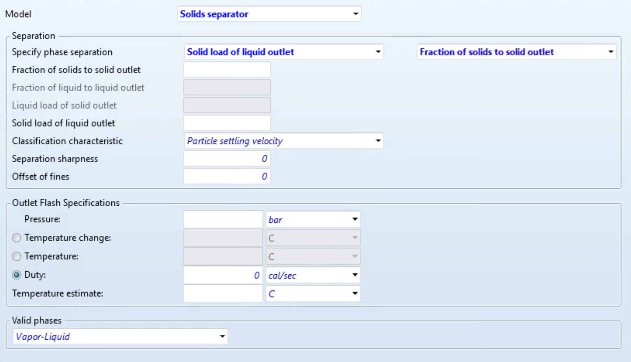
Solids Separator
Parameters: This model requires parameters such as temperature, pressure, and duty. In addition, you can also vary the type of phase separation, separation sharpness, and offset of fines.
How it Works: The feed enters through a central inlet, and the heavy solids settle against the bowl wall while clarified liquid overflows or is discharged at the opposite end.
Common Application: Wastewater treatment
Notes:
Zach

Slide 9
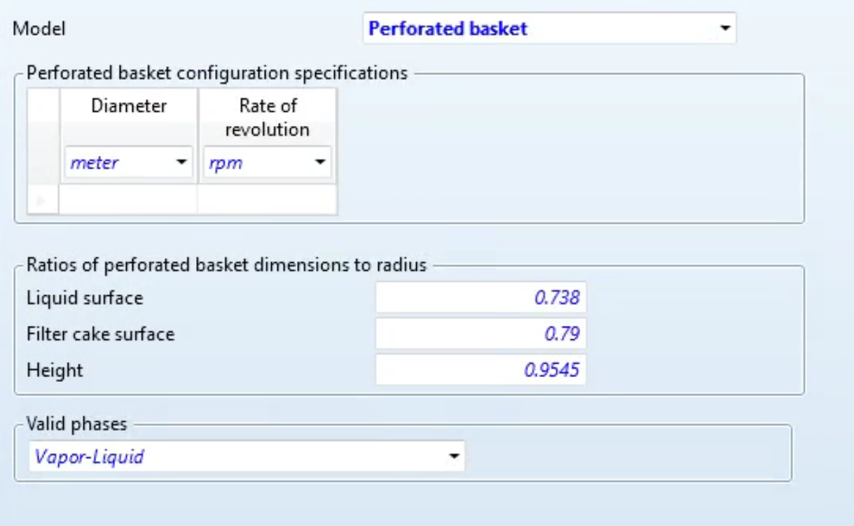
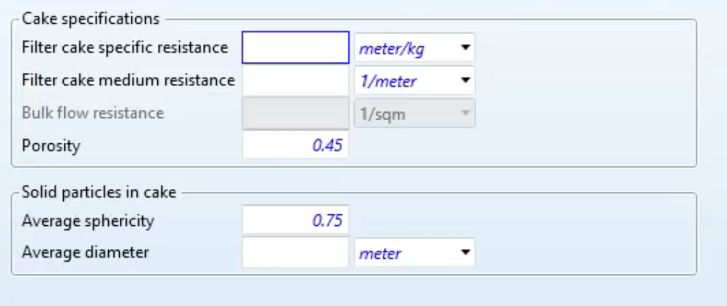
Perforated Basket
Parameters: This model requires the diameter and rpm of the centrifuge. You can also change the ratios of the perforated basket dimensions to radius.
How it works: In a perforated basket centrifuge, the rotating drum has perforations lined with a filtering medium. The centrifugal force pushes the liquid out through the perforations while the solids for a cake.
Common Application: Batch Processes such as sugar refinery.
Notes:
Zach

Slide 10
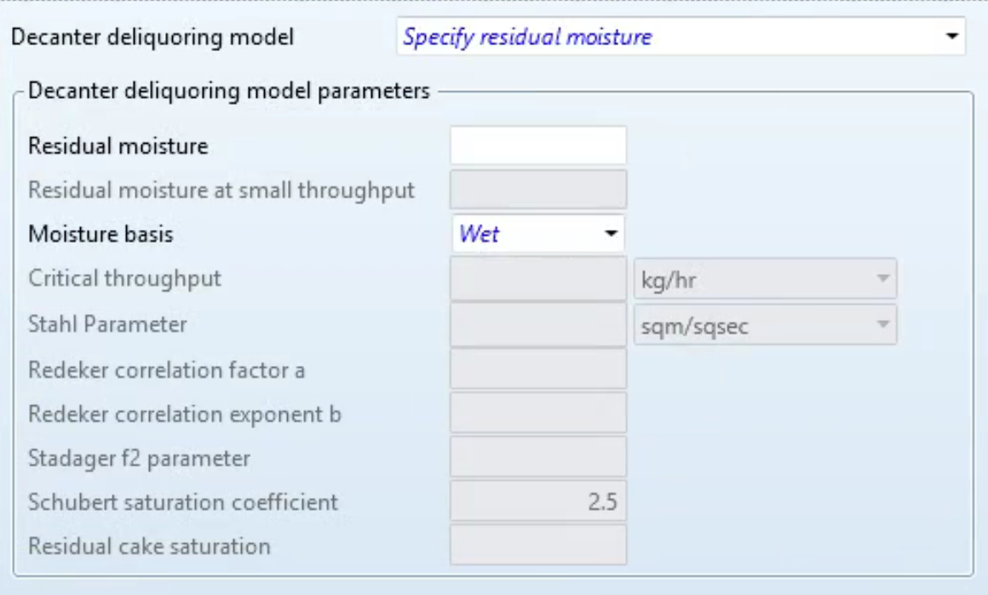
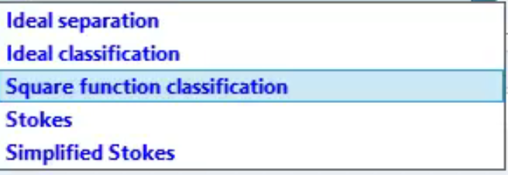
Decanter
Parameters: The decanter model requires a classification to be selected. In addition, the residual moisture parameter is needed before running the file.
How it works: Has a horizontal bowl and a conveyor inside. They rotate at different speeds. Slurry enters the feed tube and solids settle out and are conveyed along the bowl to the solids discharge, while clarified liquid overflows and exits.
Common Application: Wastewater treatment, food processing
Notes:
Zach

Slide 11
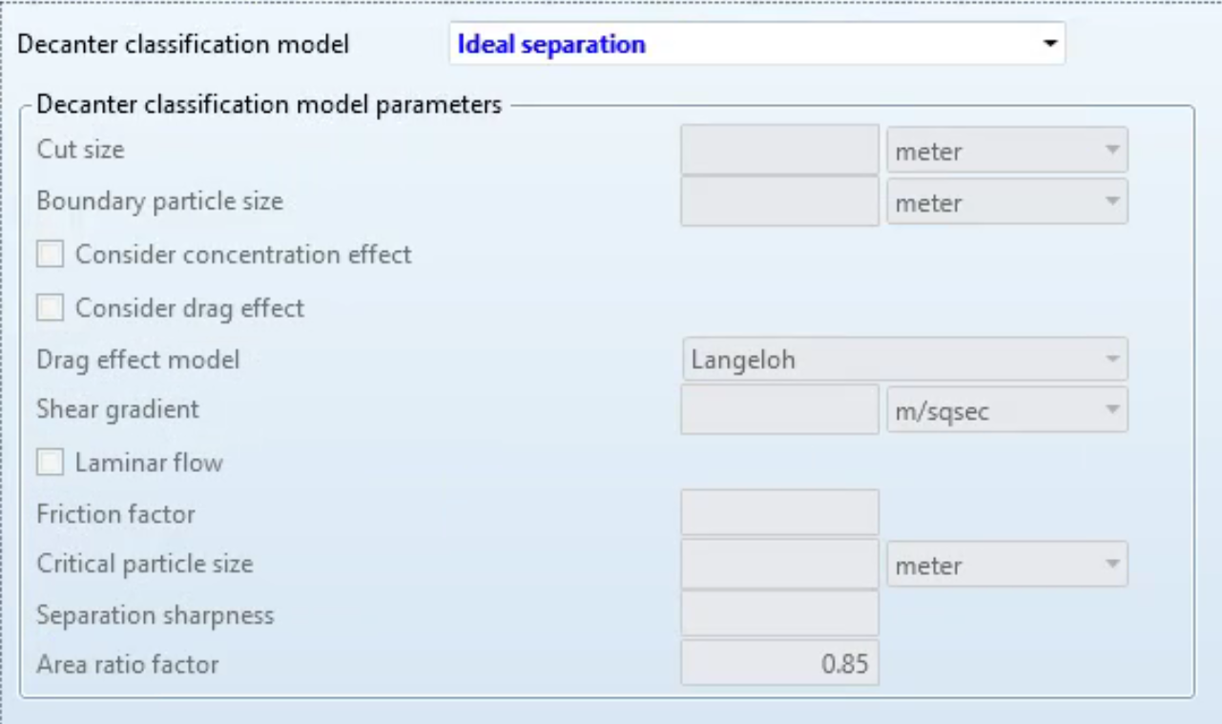
Disc
Parameters: The Disc model has the same parameters as the decanter model. However their uses and processes are different.
How it Works: A disc centrifuge has a stack of closely spaced conical discs inside a vertical, rotating bowl. The feed is introduced into the center; the increased surface area speeds up separation.
Common Application: Liquid-liquid separations such as breweries.
Notes:
James
The Disc:
So Parameters:
It uses the same parameters as the decanter model but operates differently.
How it Works:
Contains closely spaced conical discs inside a rotating bowl.
Feed enters at the center, and the increased surface area speeds up separation.
Works well for handling emulsions where two liquid phases need to be separated.
Common Applications:
Liquid-liquid separations like breweries (beer clarification, yeast removal).
Used in dairy processing (cream separation from milk).
Found in pharmaceuticals for separating biological suspensions.

Slide 12
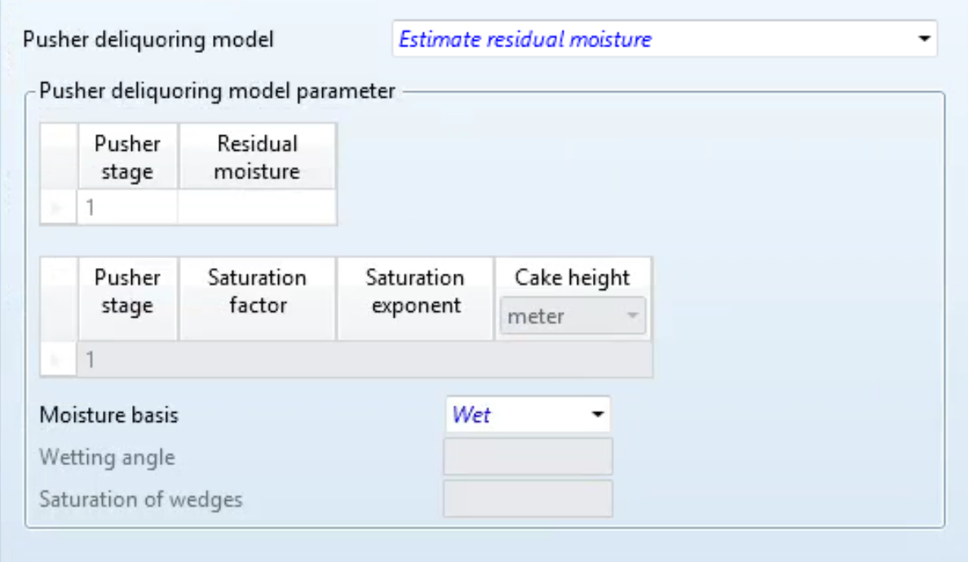
Pusher
Parameters: The Pusher model also needs the residual moisture parameter. However, it differs from the decanted and disc model by having an input for pusher stage.
How it Works: It has a perforated basket(s) and reciprocating motion that pushes the solid cake across the screen in stages, aiding the dewatering process and eventual discharge.
Common Applications: Large volume of solids, used to make fertilizer, salt, and more.
Notes:
James
Pusher:
In regards to Parameters:
It Needs a residual moisture parameter, which differs from the disc and decanter models.
Includes an input for the pusher stage, which helps move solids through.
For How it Works:
It Uses a perforated basket and reciprocating motion to push solids across a screen.
Helps with continuous dewatering and efficient solid discharge.
Some Common Applications:
Handles large volumes of solids in industries like fertilizer and salt production.
Used in plastics and polymer manufacturing for separating solid resin particles.
Applied in chemical processing for handling crystallized products.

Slide 13
Aspen Cfuge: Capabilities and Limitations
Capabilities:
Liquid-Solid Separation: Models filtration using a centrifuge to separate suspended solids from a liquid phase.
Free-Water Calculations: Accounts for the removal of unbound liquid from solid particles during filtration.
Limitations:
Rigorous Three-Phase Calculations: Cannot model systems with gas, liquid, and solid phases simultaneously.
Heating/Cooling Curves: Does not perform energy balance calculations related to temperature changes.
Water Decanter Streams: Cannot be used in systems that involve water removal or decanting of liquid phases.
Notes:
James
This is the CFuge, which is the Centrifuge filter. It Simulates centrifuge filters, and separates of liquids from solids.
The Cfuge requires a least one solid substream and Assumes separation efficiency of solids equal 1
Liquid Solid separation and free water calculations are calculations that CFUGE in Aspen can perform.
However, Rigorous Three Phase calculations, heating/cooling curves, and water decanter stream calculations are limited with the CFUGE Aspen simulation calculation system.

Slide 14
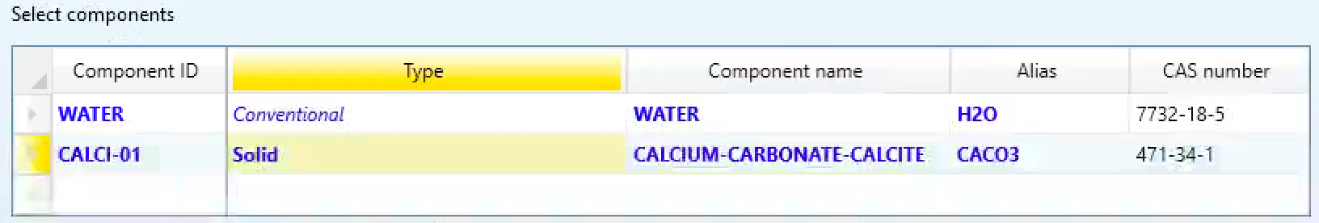
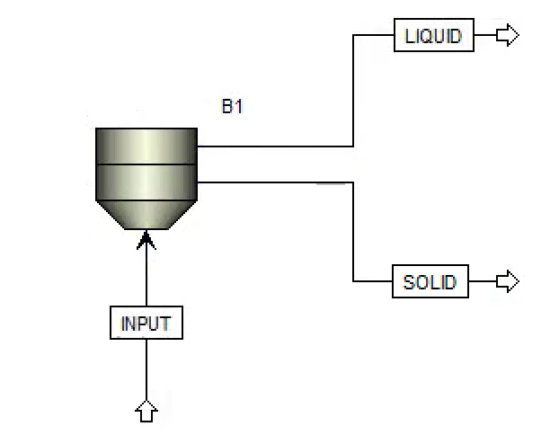
Example: Water vs. Calcium Carbonate
Properties - Component
Typical separation found in industry
Wastewater treatment, mining, chemical treatment
**Need to specify component type as “Solid” to ensure proper centrifugation**
Notes:
Allison

Slide 15
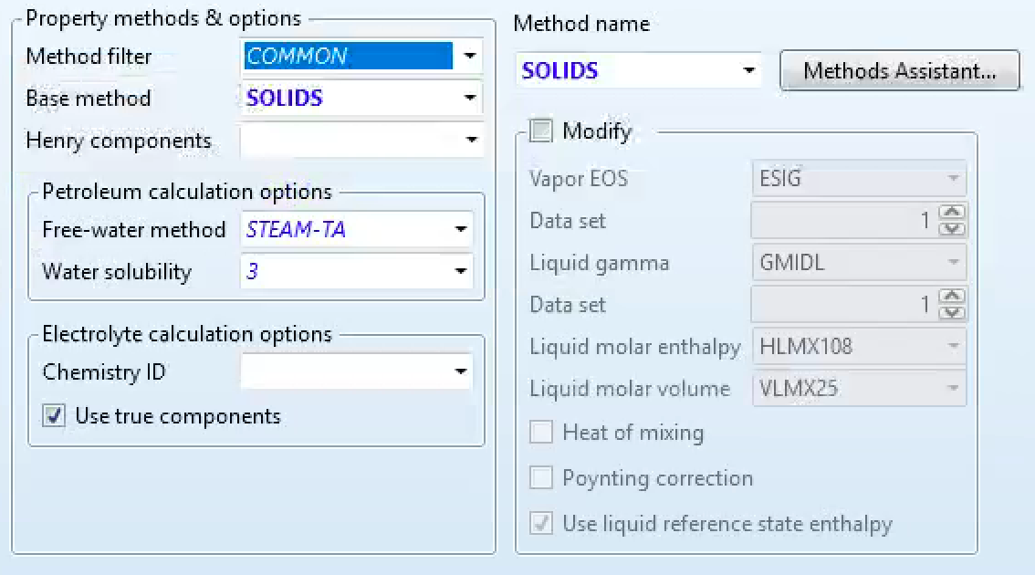
Example: Water vs. Calcium Carbonate
Properties - Method
Choose “SOLIDS” since this is a solid-liquid separation
“NRTL” typically used for liquid-liquid separation
Notes:
Allison

Slide 16
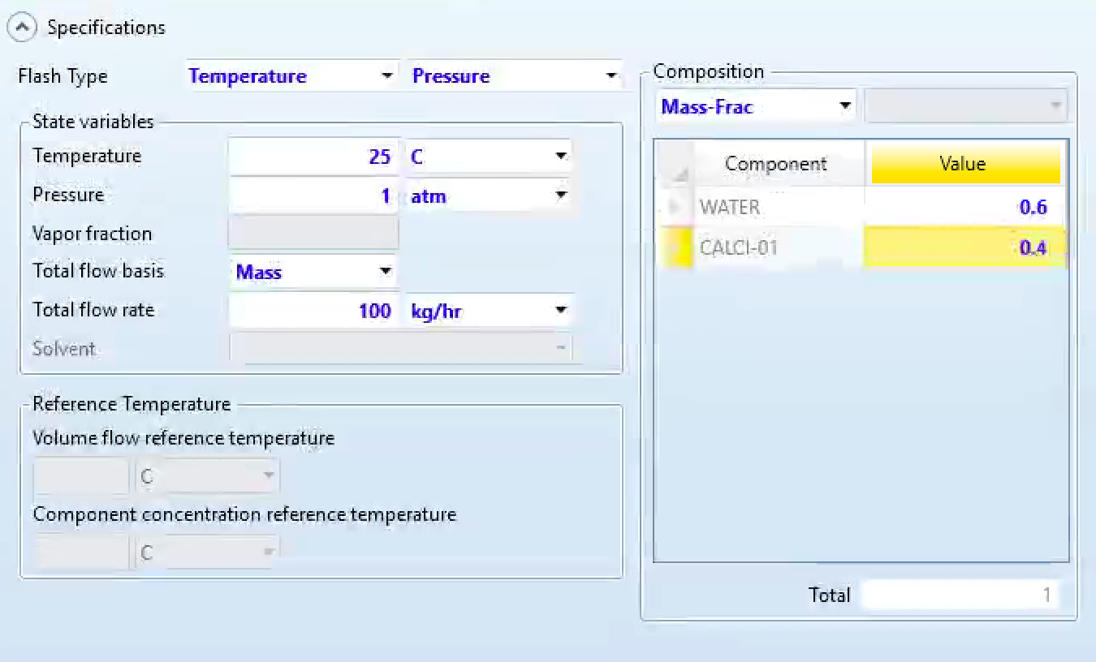
Example: Water vs. Calcium Carbonate
Notes:
Allison
Input materials
Chose temp and pressure where the components remain liquid vs solid
Arbitrary moss frac and flow rate for the example

Slide 17
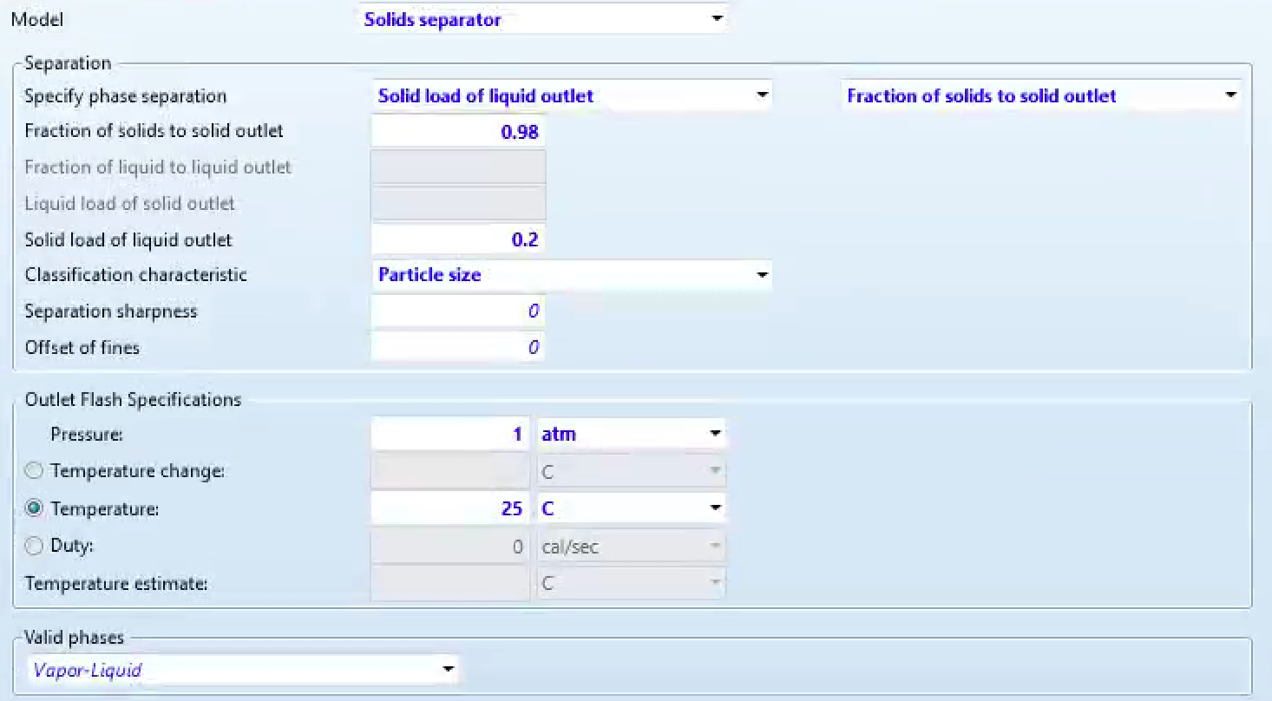
Example: Water vs. Calcium Carbonate
Notes:
Allison
cFuge block inputs

Slide 18
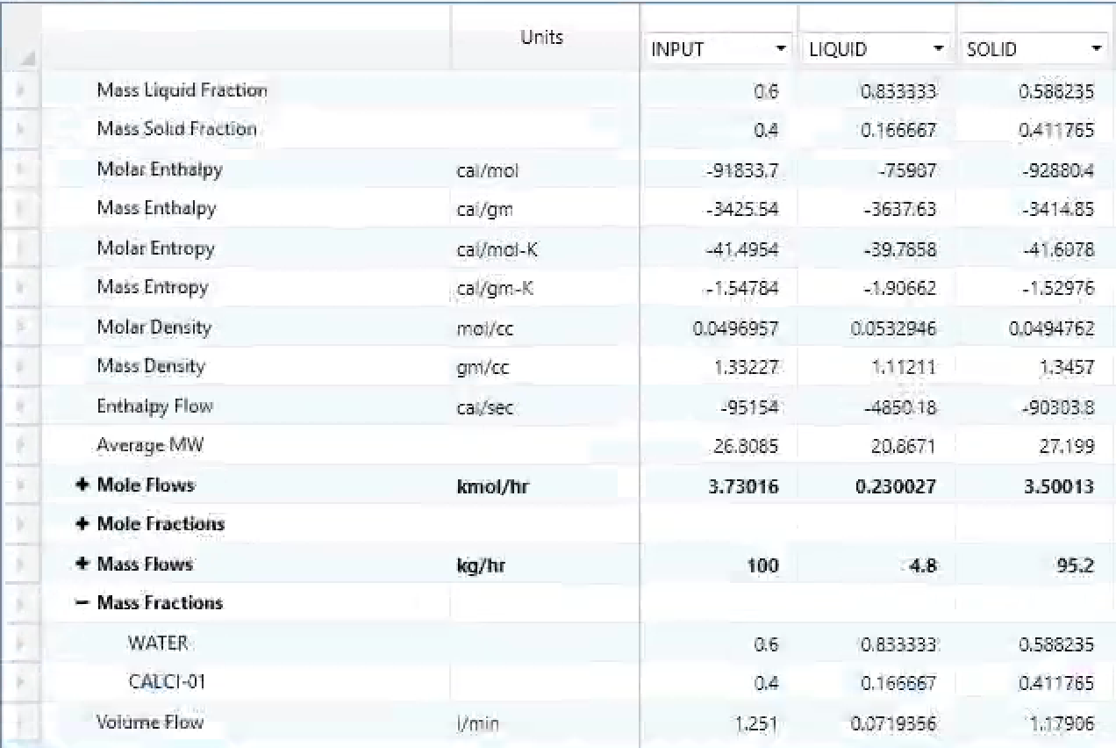
Example: Water vs. Calcium Carbonate
Notes:
Allison
outputs

Slide 19
Thanks!
Questions?

Slide 20
References
GeeksforGeeks. Photograph of Sedimentation in Water. Accessed February 2, 2025. https://www.geeksforgeeks.org/sedimentation/.
FisherSci. Centrifugation. Accessed February 2, 2025. https://www.fishersci.se/se/en/scientific-products/centrifuge-guide/centrifugation-theory.html.
ProProfs. Centripetal Forces. Accessed February 2, 2025. https://www.proprofs.com/quiz-school/quizzes/centrifugal-and-centripetal-forces-quiz.
Water and Wastewater. Photograph of Centrifuges in Wastewater Treatment. Accessed February 2, 2025. https://www.waterandwastewater.com/centrifuges-in-wastewater-treatment-enhancing-efficiency-and-purity/
Landry Healthcare. Photograph of Platelet-Rich Plasma (PRP) Equipment. Accessed February 2, 2025. https://landryhealthcare.com/services/platelet-rich-plasma-injections/.
Tetrapak. Whole Milk Processing. Accessed February 2, 2025. https://dairyprocessinghandbook.tetrapak.com/chapter/centrifugal-separators-and-milk-standardization.

Slide 21
References
Oil & Gas IQ. Oil and Gas Companies. Accessed February 2, 2025. https://www.oilandgasiq.com/strategy-management-and-information/articles/oil-and-gas-companies.
WVODESIGNS. Perforated Basket Centrifuge - 50kg. Accessed February 2, 2025. https://www.wvodesigns.com/perforated-basket-centrifuge-50kg-724.html.
Centrisys/CNP. Decanter Centrifuge Spare Rotating Assemblies Explained. Accessed February 2, 2025. https://www.centrisys-cnp.com/blog/decanter-centrifuge-spare-rotating-assemblies-explained.
Machinery Lubrication. Disc Stack Centrifuge. Accessed February 2, 2025. https://www.machinerylubrication.com/Read/31902/disc-stack-centrifuge.
Sultrade. Pusher Centrifuges - Continuous Centrifuge. Accessed February 2, 2025. https://www.sultrade.cz/en/pusher-centrifuges-continuous-centrifuge/.
Wikipedia. Solid Bowl Centrifuge. Accessed February 2, 2025. https://en.wikipedia.org/wiki/Solid_bowl_centrifuge.
ChatGPT (OpenAI). Explanation of “Solids Separator, Perforated Basket, Decanter, Disc, and Pusher” Centrifugation Models; personal communication, February 2, 2025.

